Slide 1
Null resource
In Terraform, a "null resource" is a special resource type that allows you to execute arbitrary actions on the local machine where Terraform is running. It doesn't interact directly with any infrastructure provider (like AWS, Azure, etc.) but instead is used for tasks that Terraform cannot manage directly through its typical resource providers.

Slide 2
Common Use Cases for Null Resources
Local Provisioning: Executing scripts or commands on the local machine or a remote machine via SSH.
Post-Deployment Configuration: Performing configuration tasks that are not managed by Terraform providers, such as initializing a database schema or configuring software.
Dependencies Between Resources: Creating dependencies where Terraforms dependency system alone isn't sufficient or appropriate.

Slide 3
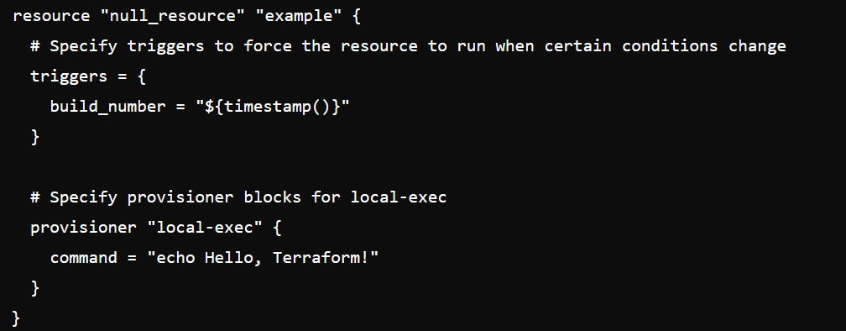
Code

Slide 4
Code Explaination
Resource Type: null_resource indicates it’s a null resource.
Resource Name: "example" is the name given to this resource block, which can be used to refer to it elsewhere in your Terraform configuration.
Triggers: This is an optional block where you define conditions under which Terraform should re-run this resource. In the example, ${timestamp()} ensures the command runs whenever the timestamp changes, essentially on every apply.
Provisioner: This block specifies what action to perform locally. In this case, "local-exec" is used to execute a local command ("echo Hello, Terraform!"). Other provisioners like "remote-exec" can be used for SSH-based commands.

